Slide 1
Recipe Finder
Created by Jordan, Bryce, Roger

Slide 2
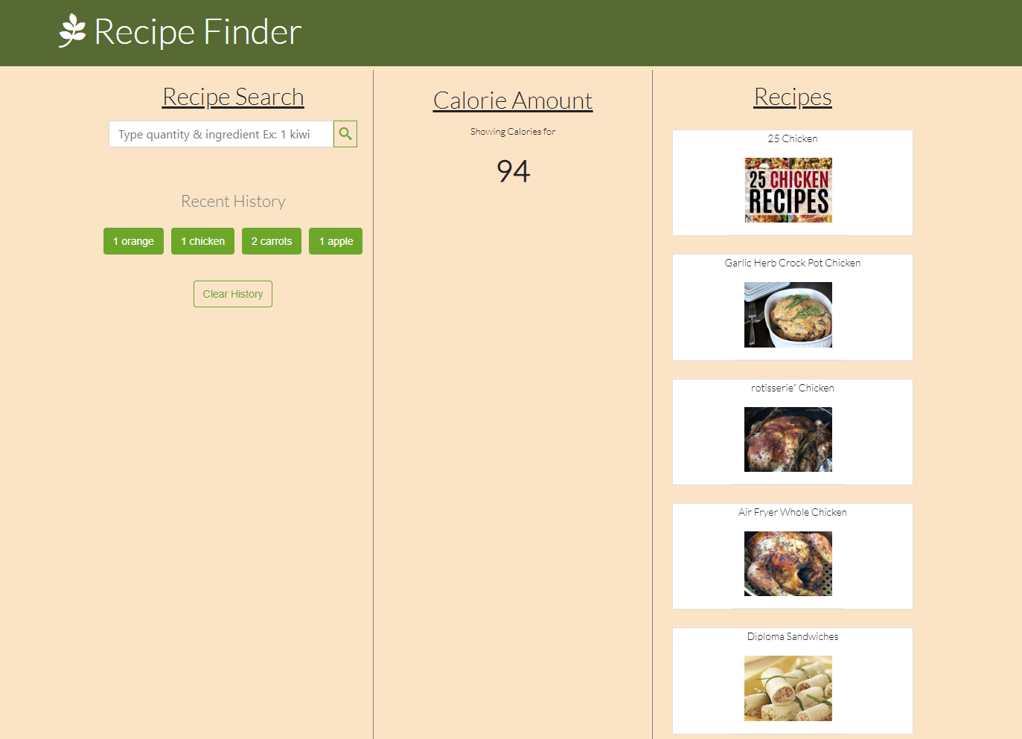


Slide 3

User Story:
AS A stay-at-home dad
I WANT to search for a recipe and its calories
SO THAT I can watch my weight
WHEN I search for an ingredient
THEN I am presented with a display of recipes
AND includes its calories

Slide 4
Process
Technologies: (HTML, CSS, JavaScript)
APIs used: (Spoonacular, Edamam Nutrition Info)
Tasks and roles: (Bryce, Jordan, Roger)
Challenges: (Infinite loops, 402 error, localStorage)
Successes: (Effective communication, participation as a team, no git issues)

Slide 5
https://salgorog.github.io/recipe-finder/
Demo

Slide 6
Directions for Future Development
Comprehensive guide for nutrition facts
Link to a detailed recipe
Integration with Pinterest
Ability to search for multiple ingredients
Expanding API potential

Slide 7
Links
https://salgorog.github.io/recipe-finder/
https://github.com/salgorog/recipe-finder/

